Slide 1
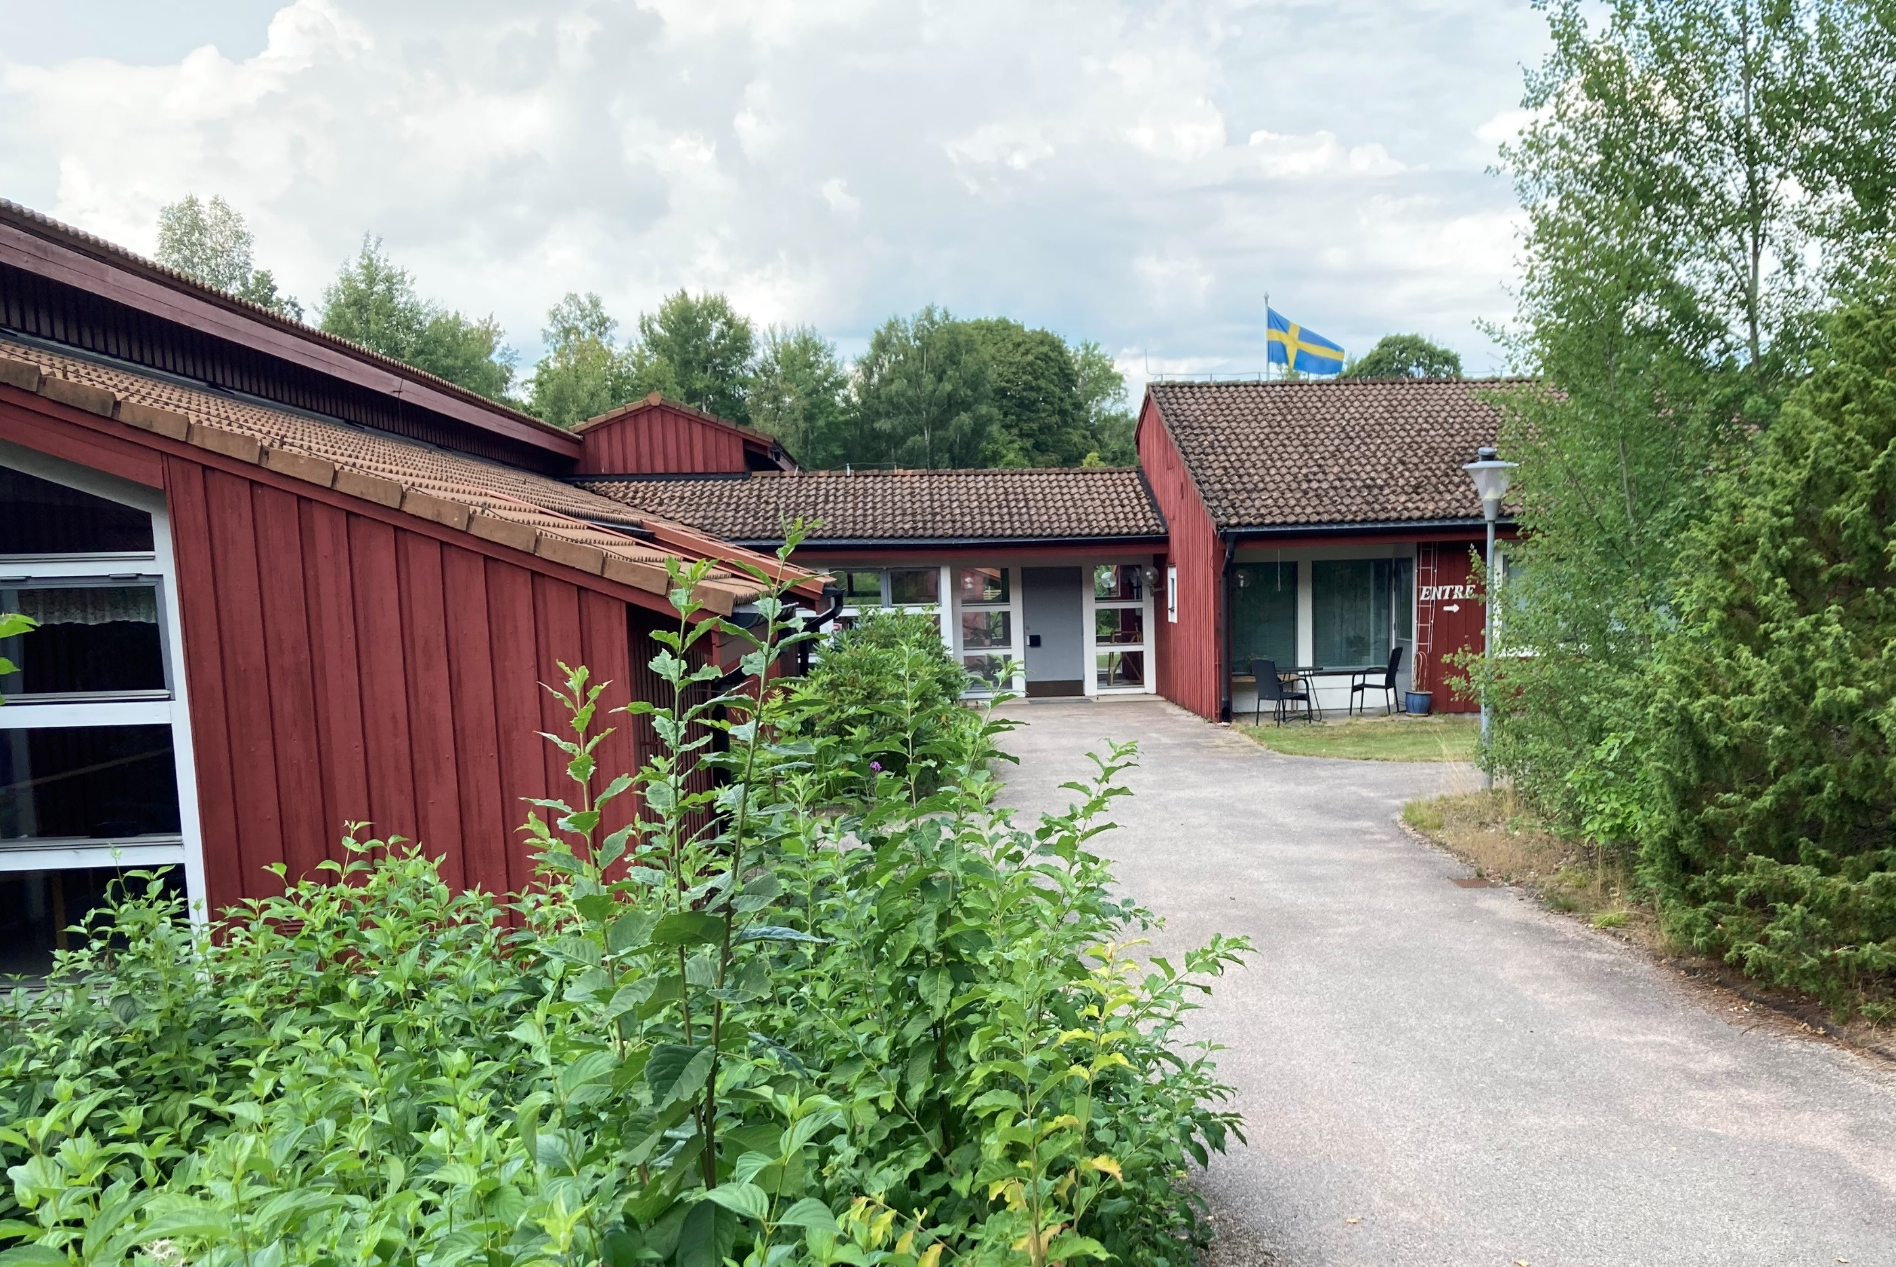
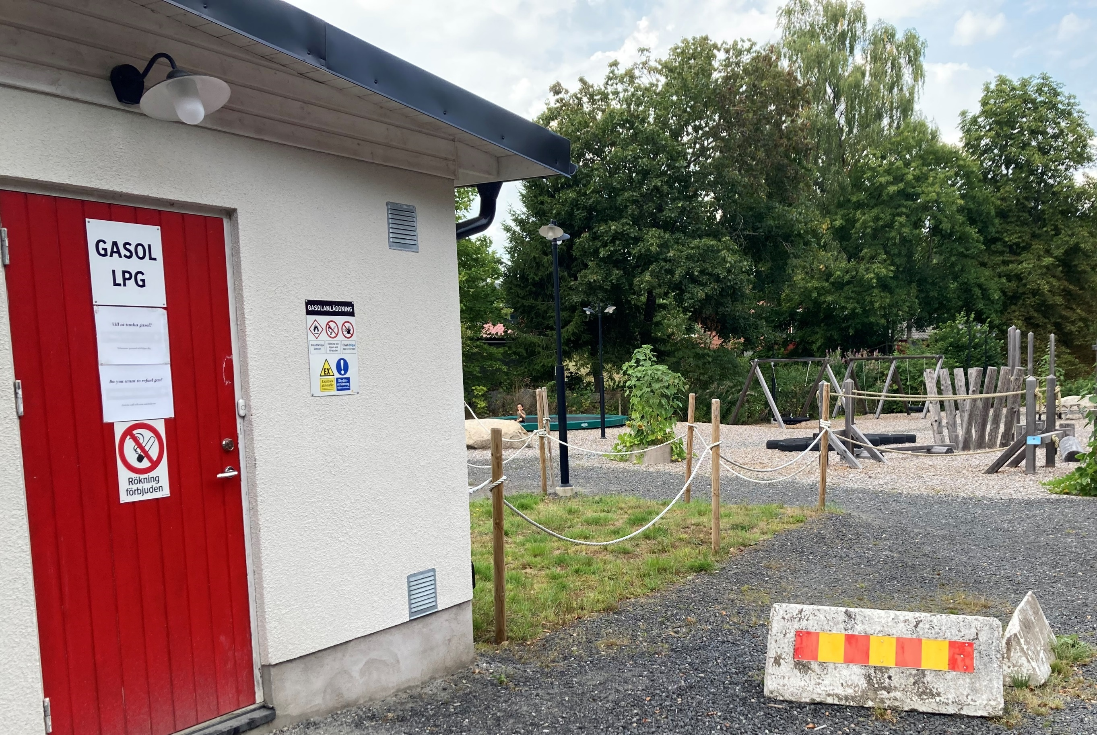
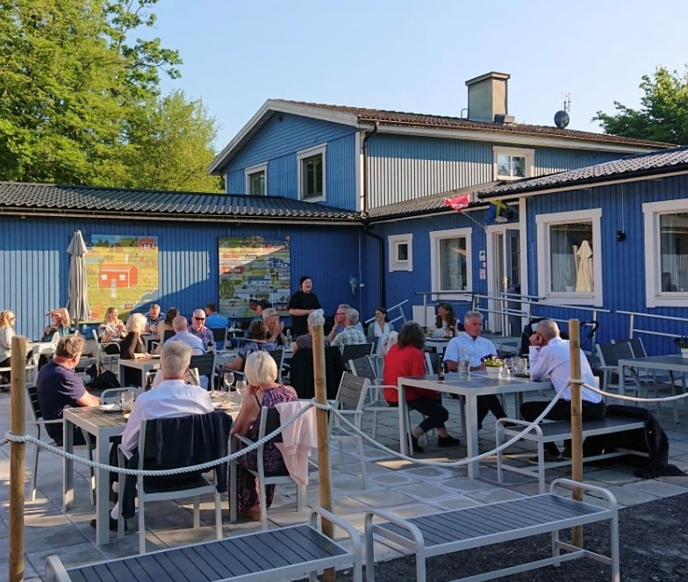
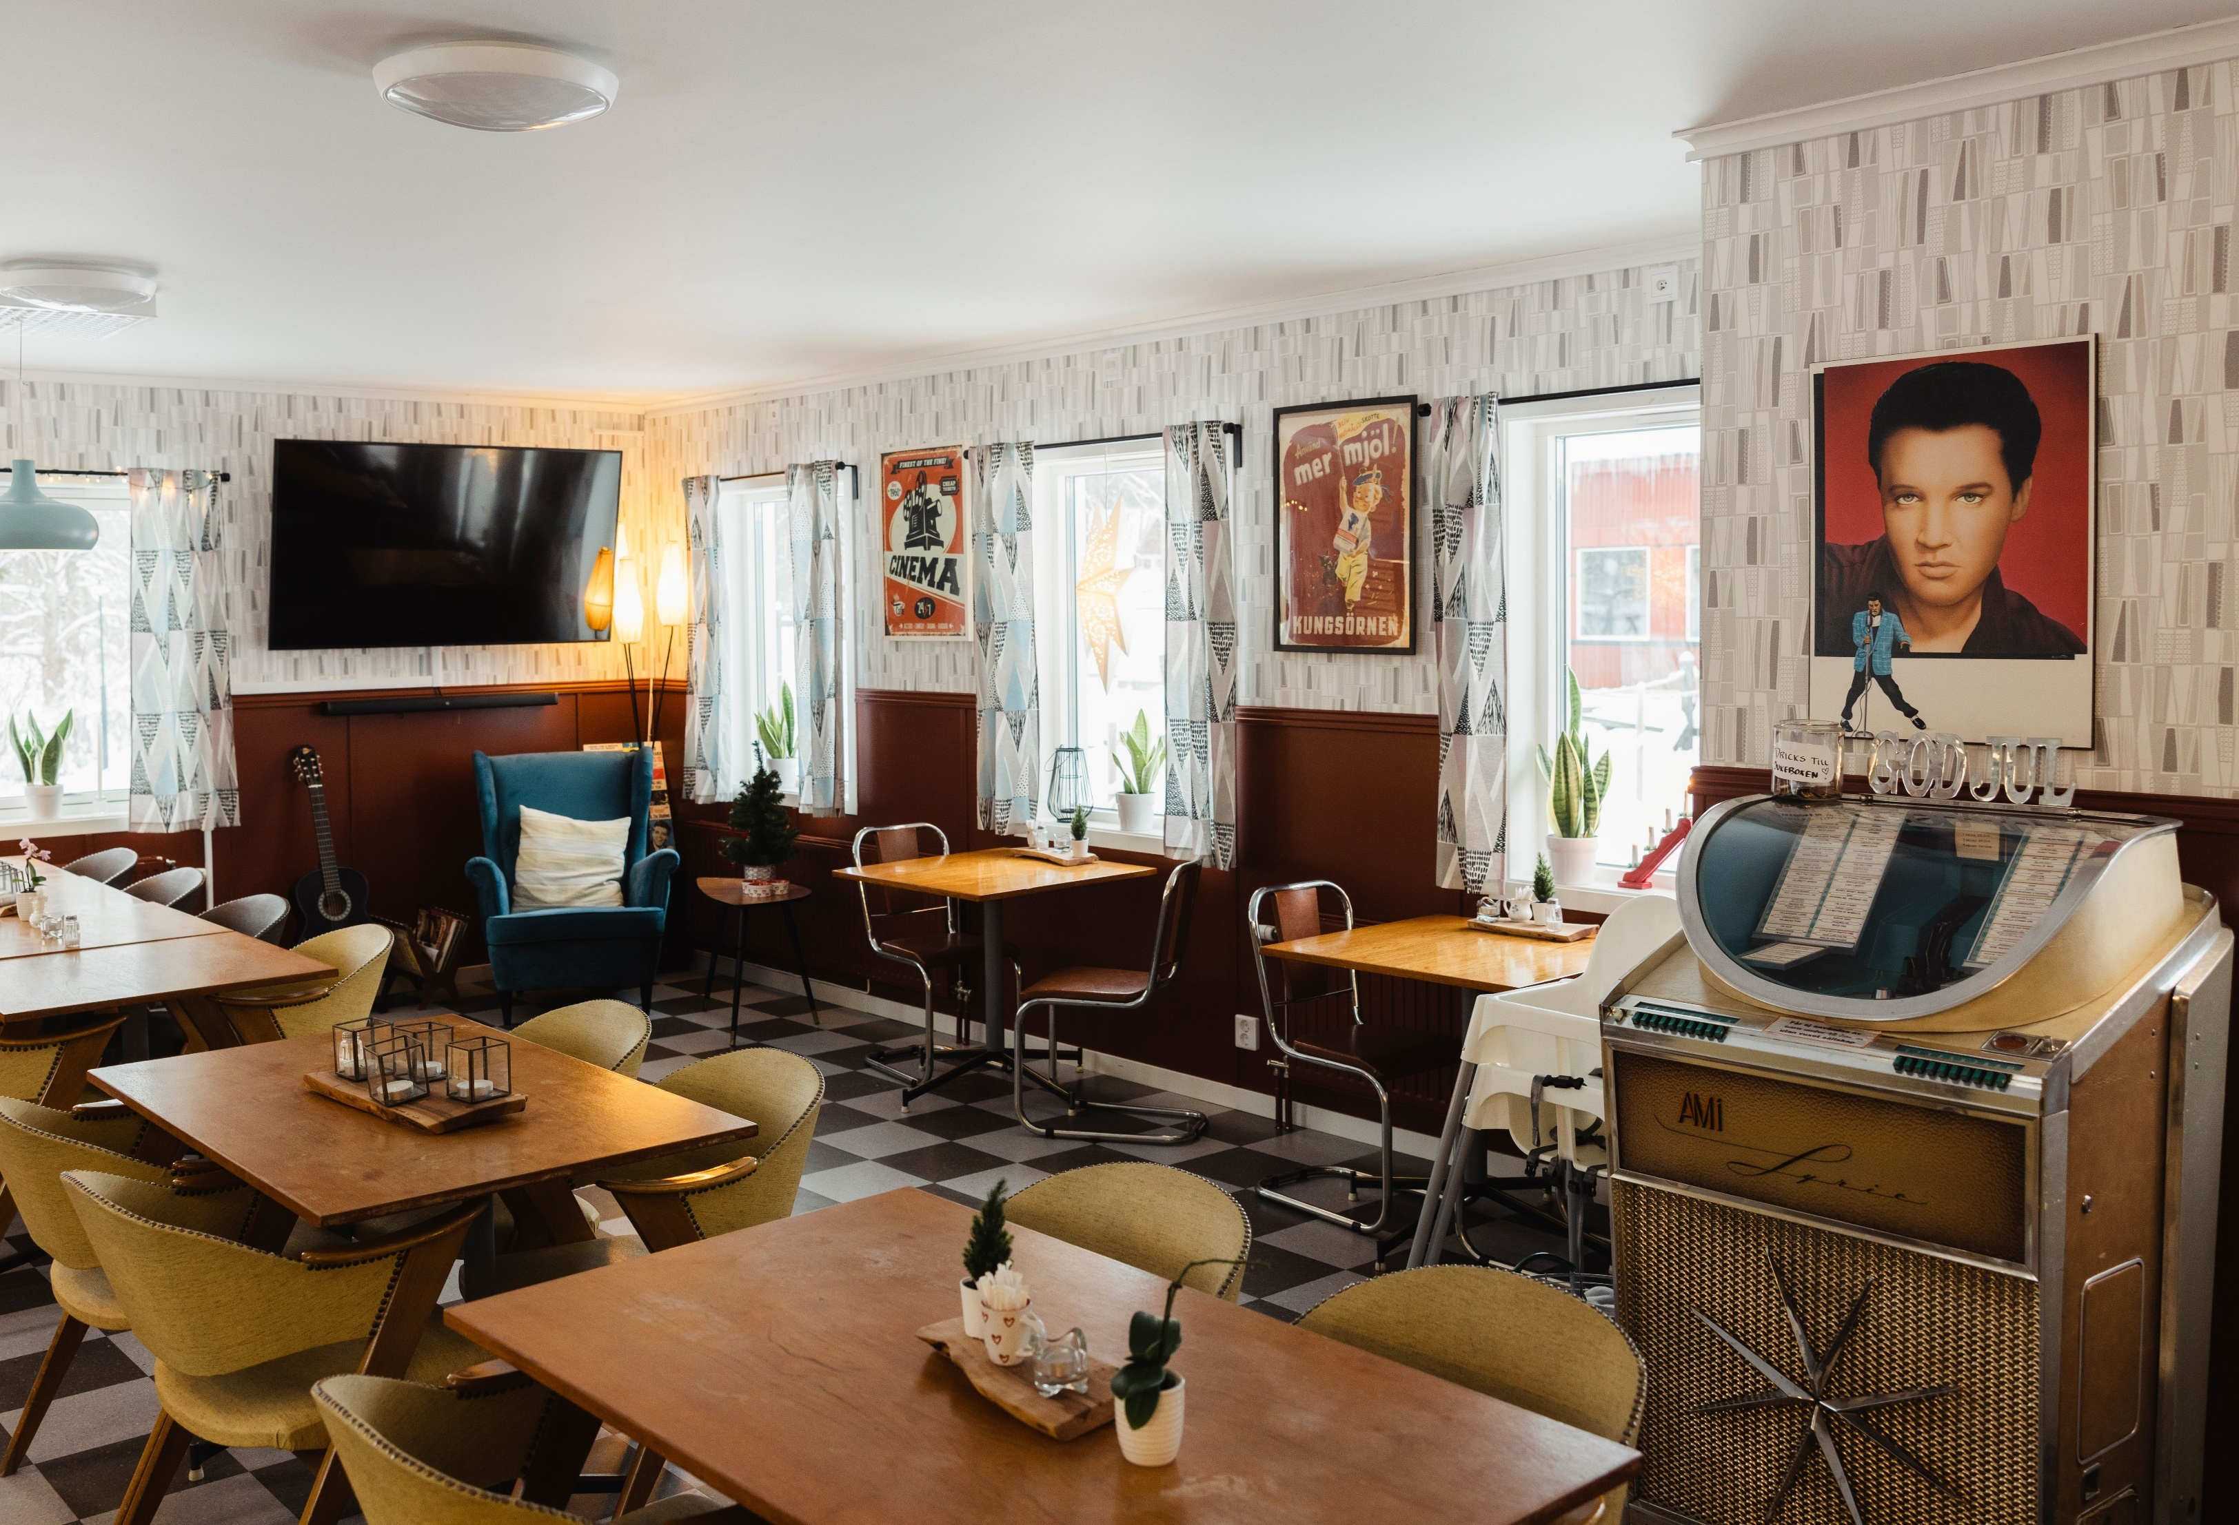
Häradsbäck
Prepared, resilient, selfsustained
Det här fotot av Okänd författare licensieras enligt CC BY-NC

Slide 2
Havsvind i syd
Resilient local energy system with solar panels and hydrogen
Hans-Olof Stålgren hansolof.stalgren@telia.com
Graz/Stanz. 2023-05-10

Slide 3
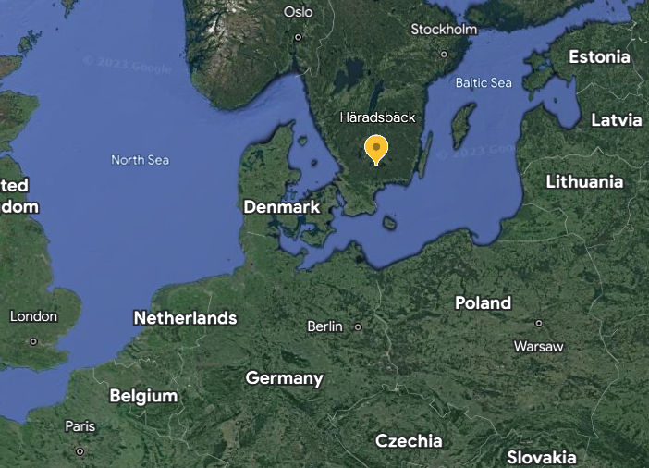
Häradsbäck village is a part of Härlunda parish, with a total of 450 inhabitants. The village, with 158 inhabitants, is situated not so far from the municipality centre of Älmhult. The inhabitants are mostly older people. Most of the work places are in Älmhult municipality with IKEA as a big employer.
Over the years the villagers, through the village association and its limited company,Härlundabygden AB (svb), have managed to achieve funding from different sources with a total amount of more than 3 million euro. The company has in fact become the single largest employer in the village with a total of 15 employees today.
Notes:
Sammanfattning genom modellen och koppling till IOP

Slide 4
A little bit of history
Development often starts with a threat …. or more.
Local firebrigade
Changing zip code
Closing the local shop
Closing the elderly home
Closing the primary school
Electricity blackout
Lack of broadband
1980
1990
2002
2007
2010
2012
2014
2018
2019
2020
2023

Slide 5
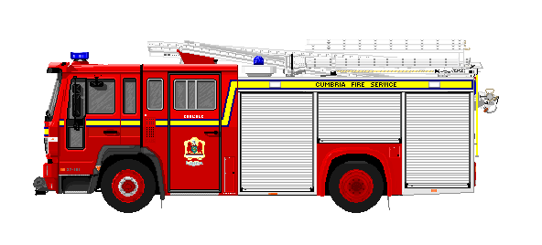
A little bit of history
Development often starts with a threat …. or more.
Local firebrigade
Changing zip code
Closing the local shop
Closing the elderly home
Closing the primary school
Electricity blackout
Lack of broadband
1980 closing the local firebrigade Then the village association was founded As a result there was a voluntary firebrigade
1980
1990
2002
2005
2007
2010
2012
2014
2018
2019
2020

Slide 6
A little bit of history
Development often starts with a threat …. or more.
Local firebrigade
Changing zip code
Closing the local shop
Closing the elderly home
Closing the primary school
Electricity blackout
Lack of broadband
Change of the local zipcode for Häradsbäck and just be called Älmhult. The village association fought and won.
34392 Häradsbäck
1980
1990
2002
2005
2007
2010
2012
2014
2018
2019
2020

Slide 7
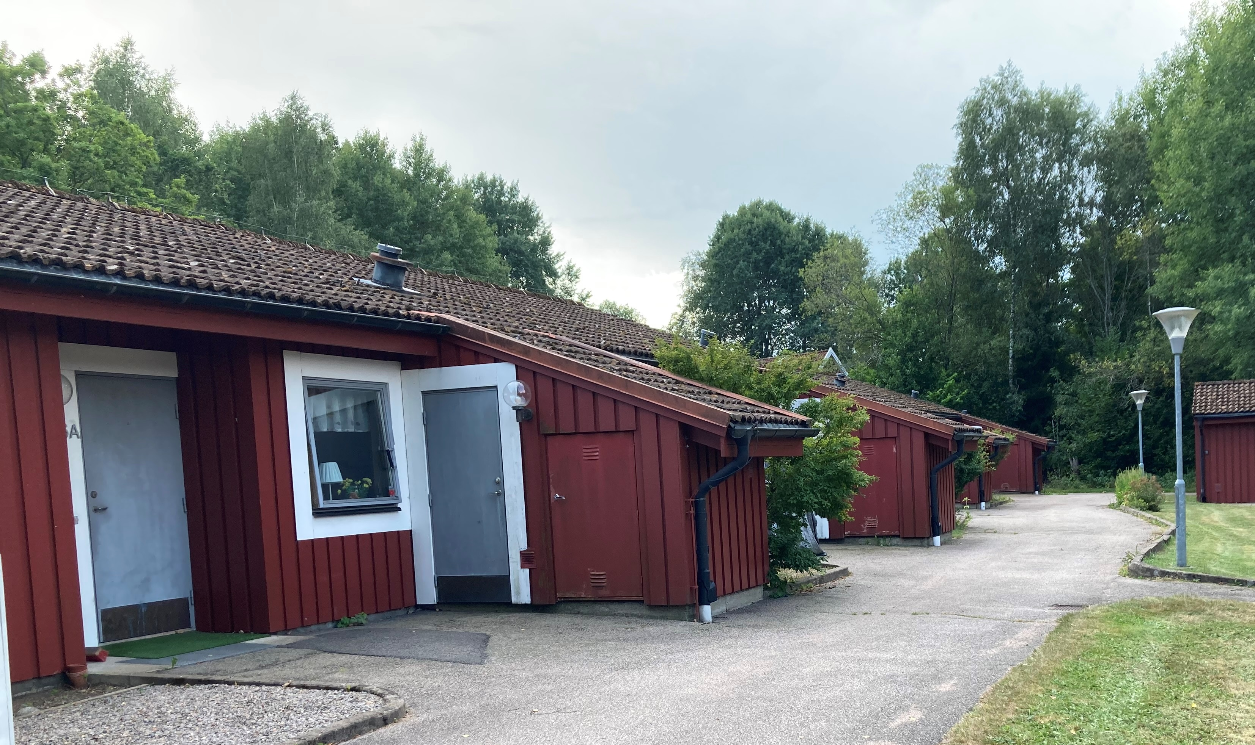
A little bit of history
Development often starts with a threat …. or more.
Local firebrigade
Changing zip code
Closing the local shop
Closing the elderly home
Closing the primary school
Electricity blackout
Lack of broadband
From 2002 to 2017, the local shop, the school and the elderly home were closed.
The village association bought the premises to run the shop. Later on also the elderly home.
1980
1990
2002
2005
2010
2012
2014
2017
2018
2019
2020

Slide 8
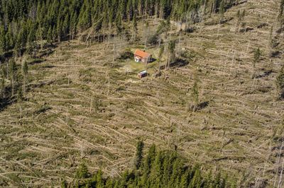
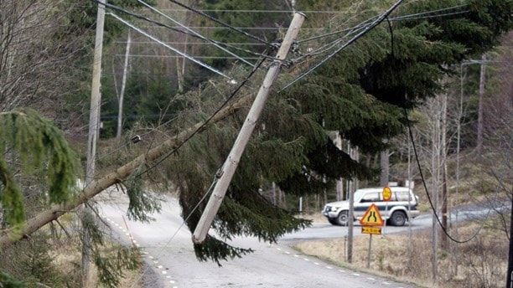
A little bit of history
Development often starts with a threat …. or more.
Local firebrigade
Changing zip code
Closing the local shop
Closing the elderly home
Closing the primary school
Electricity blackout
Lack of broadband
2005 the storm Gudrun hit the area leaving Häradsbäck without electricity for 30 days.
1980
1990
2002
2005
2007
2010
2012
2014
2018
2019
2020

Slide 9
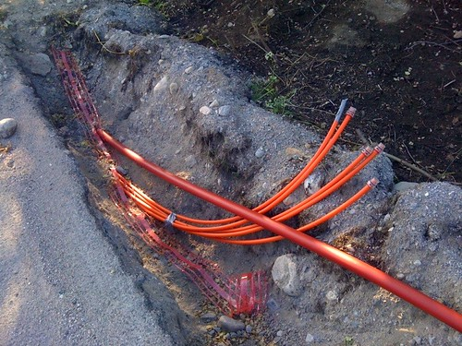
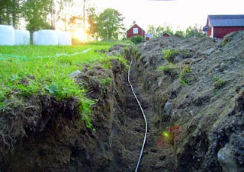
A little bit of history
Development often starts with a threat …. or more.
Local firebrigade
Changing zip code
Closing the local shop
Closing the elderly home
Closing the primary school
Electricity blackout
Lack of broadband
2007-2014 was a long struggle for broadband via fiber. Now all the households in the parish have fiber. Financed 50% from the ERDF and 50% each household paying.
1980
1990
2002
2005
2007
2010
2012
2014
2018
2019
2020

Slide 10
Running services means business
Local firebrigade
Changing zip code
Closing the local shop
Closing the elderly home
Closing the primary school
Lack of broadband
Electricity blackout
Starting a village owned company
2018, in order to run the businesses in the shop, the elderly home, the restaurant, tourism etc, the village association formed a limited company.
Härlundabygden AB (svb) with limitations for use of profits.
Over the years the village association has gathered about € 3 million in funding from different sources.
1980
1980
1990
1990
2020
2018
2020
2018
2019
2005
2012
2019
2010
2012
2010
2014
2002
2014
2002
2007
2007

Slide 11
Lessons learned from history and Gudrun
Together in the village we can make a change
With joint local resources we can solve lots of things
We have to prepare for electricity blackouts or other crises
Centralised systems are vulnerable in a crisis. Local systems are often more resilient.
In towns and cities the rescue services are provided for by authorities.
In rural areas we ourselves are the first responders
We have to produce (and store) energy locally
1980
1990
2002
2007
2010
2012
2014
2018
2019
2020
2023

Slide 12
A socio-technical project 2022-2024
Aiming at rural resilience, a contribution to the transition due to climate
A model for rural areas, complementary to public organisation
Local Resource Group (LRG) to meet challenges at societal disturbances,
Local energy production and storage of energy in hydrogen gas for emergenies
1980
1980
1990
1990
2020
2018
2020
2022
2023
2018
2019
2005
2012
2019
2010
2012
2010
2014
2002
2014
2002
2007
2007
Notes:
An LRG is locally built and based in the local needs
An LRG consists of people from local community working for it in cases of crisis
An LRG is organising and training local resources to act efficiently

Slide 13
What does an LRG do?
Acute tasks in case of a crisis, disaster and even war
Supply of necessities, help, support and transport
Information and communication
Node for contacts and connections
Safety point with groceries, cooked food, showers, laundry and social meetings
1980
1980
1990
1990
2020
2018
2020
2022
2023
2018
2019
2012
2019
2010
2012
2010
2014
2002
2014
2002
2007
2007
Notes:
Lokalt räddningsvärn och LRF-avdelning är viktiga partners i en LRGs arbete
Områdesansvariga / biträdande som ingår i ledningsgrupp vid kris
Ledningsgruppen upprättar en sambandscentral när det behövs

Slide 14
Service, information and security point
Energy supply in events of crisis
Solar electricity and hydrogen production
Hydrogen storage and refueling station
Local vegetable and fish production
Prepared for crisis
Green transition
Local economy
Strengtened local economy.
Higher level of selfsufficiency
Notes:
Sammanfattning genom modellen och koppling till IOP

Slide 15
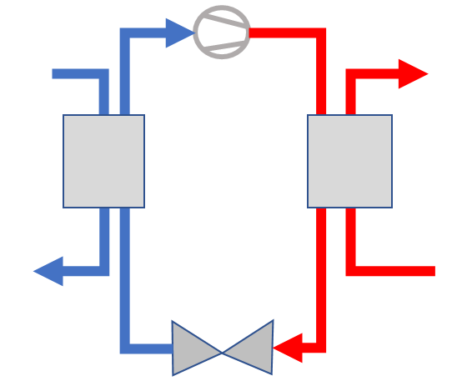
Electricity
Hydrogen
Oxygen
Heat
Crisis system
Hydrogen- Commercial
Electricity to grid
Grid
Compressed H2
200 – 350 bar
H2 Buffer 5-10 kg
H2 storage
1500 kg
Electrolyzer 500 kW
Battery
100 kW
Solar PVs
3 MW
H2 storage 300 kg
Heat storage
H₂
Filling station
>100 kg/day
Buffer
Compressed H2
350 -900 bar
Community
Fuel cell ca 100 kW

Slide 16
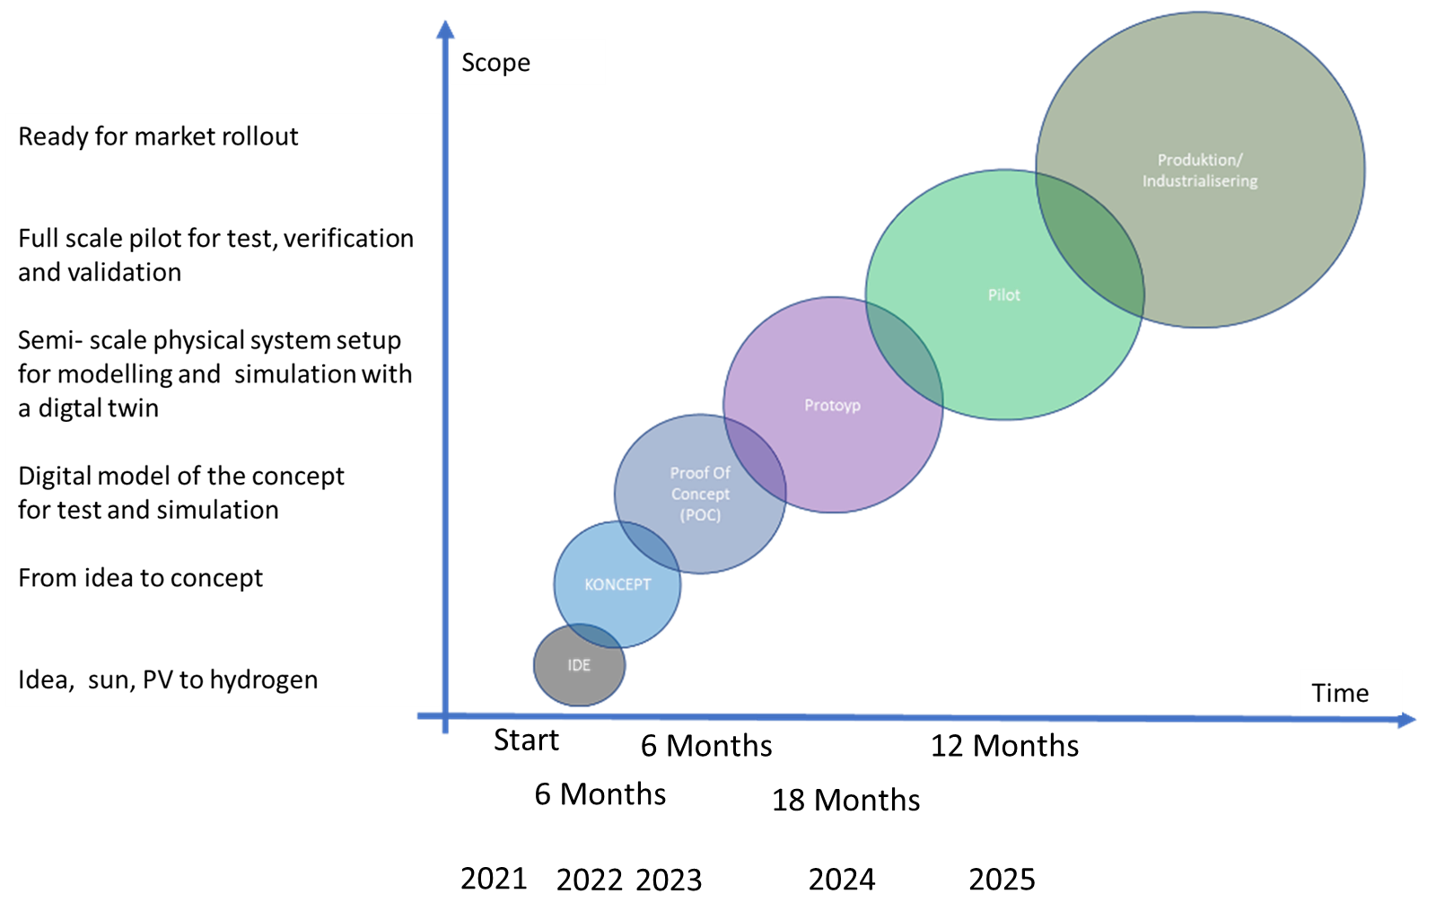

Slide 17
Thank you for your attention!
Hans-Olof Stålgren hansolof.stalgren@telia.com
Project manager
Mette Adolfsson mette.adolfsson@haradsback.se
https://haradsback.se/
1980
1980
1990
1990
2020
2018
2020
2022
2023
2018
2019
2012
2019
2010
2012
2010
2014
2002
2014
2002
2007
2007

Slide 18
